Slide 1
Object Oriented Programming in JAVA
(Practical#12)

Slide 2
Objective: To become familiar with Exception Handling.
What is an Exception?
Definition: An exception is an indication of a problem that occurs during a program’s execution. OR
An exception is an event that occurs during the execution of a program that disrupts the normal flow of instructions.
An exception is a problem that arises during the execution of a program.
When an Exception occurs the normal flow of the program is disrupted and the program/Application terminates abnormally, which is not recommended, therefore, these exceptions are to be handled.

Slide 3
Exception Handling
What is Exception Handling ?
Definition: The exception handling in java is one of the powerful mechanisms to handle the runtime problems so that normal flow of the application can be maintained.
Exception Handling provides the programmer the ability to write programs that can resolve (i.e. catch or handle) exceptions.
Advantage of Exception Handling
The core advantage of exception handling is to maintain the normal flow of the application. Exception normally disrupts the normal flow of the application that is why we use exception handling.

Slide 4
Exception Handling
Let's take a scenario:
statement 1;
statement 2;
statement 3; //exception occurs
statement 4;
statement 5;
statement 6;
Suppose there are 6 statements in your program and there occurs an exception at statement 3, rest of the code will not be executed i.e. statement 4 to 6 will not run. If we perform exception handling, rest of the statement will be executed. That is why we use exception handling.

Slide 5
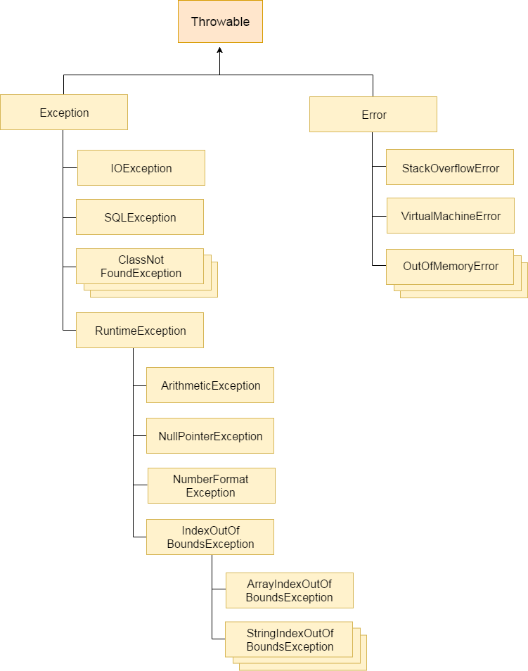

Slide 6
Exception Handling
There are mainly two types of exceptions: checked and unchecked where error is considered as unchecked exception.
The sun microsystem says there are two types of exceptions:
Checked Exception
Unchecked Exception

Slide 7
Difference between checked and unchecked exceptions
The main difference between checked and unchecked exception is that the checked exceptions are checked at compile-time while unchecked exceptions are checked at runtime.
What are checked exceptions?
Checked exceptions are checked at compile-time. It means if a method is throwing a checked exception then it should handle the exception using try-catch block or it should declare the exception using throws keyword, otherwise the program will give a compilation error.
Unchecked exceptions are not checked at compile time. It means if your program is throwing an unchecked exception and even if you didn’t handle/declare that exception, the program won’t give a compilation error. Most of the times these exception occurs due to the bad data provided by user during the user-program interaction. It is up to the programmer to judge the conditions in advance, that can cause such exceptions and handle them appropriately. All Unchecked exceptions are direct sub classes of RuntimeException class.

Slide 8
Difference between checked and unchecked exceptions
1) Checked Exception
The classes that extend Throwable class except RuntimeException and Error are known as checked exceptions
Examples IOException, SQLException etc. Checked exceptions are checked at compile-time.
2) Unchecked Exception
The classes that extend RuntimeException are known as unchecked exceptions
Examples: ArithmeticException, NullPointerException, ArrayIndexOutOfBoundsException etc. Unchecked exceptions are not checked at compile-time rather they are checked at runtime.

Slide 9
Exception Handling
Java Exception Handling Keywords
There are 5 keywords used in java exception handling.
try
catch
finally
throw
throws

Slide 10
Exception Handling
Java try block is used to enclose the code that might throw an exception.
If an exception occurs the remaining code in the try block will be skipped.
Java try block must be followed by either catch or finally block.
Syntax of java try-catch
try{ //code that may throw exception }
catch(Exception_class_Name ref){ }
Syntax of try-finally block
try{ //code that may throw exception }
finally{ }

Slide 11
Exception Handling
catch block is used to handle or resolve the Exception. It must be used after the try block only.
You can use multiple catch block with a single try.
Problem without exception handling
Let's try to understand the problem if we don't use try-catch block.
public class Testtrycatch1{
public static void main(String args[]) {
int data=50/0;//may throw exception
System.out.println("rest of the code...") ;} }
As displayed in the above example, rest of the code is not executed (in such case, rest of the code... statement is not printed).
There can be 100 lines of code after exception. So all the code after exception will not be executed.

Slide 12
Exception Handling
Solution by exception handling
Let's see the solution of above problem by java try-catch block.
public class Testtrycatch2{
public static void main(String args[]){
try{
int data=50/0;
} catch(ArithmeticException e){System.out.println(e);}
System.out.println("rest of the code...");
}
}
Now, as displayed in the above example, rest of the code is executed i.e. rest of the code... statement is printed.

Slide 13
Java Multi catch block If you have to perform different tasks at the occurrence of different Exceptions, use java multi catch block.
simple example of java multi-catch block.
public class TestMultipleCatchBlock {
public static void main(String args[]){
try{
int a[]=new int[5];
a[5]=5;
Int result 30/0;
}
catch(ArithmeticException e){System.out.println("task1 is completed");}
catch(ArrayIndexOutOfBoundsException e){System.out.println("task 2 completed");}
catch(Exception e){System.out.println("common task completed");}
System.out.println("rest of the code..."); } }

Slide 14
Exception Handling
Java finally block is a block that is used to execute important code such as closing connection, stream etc.
Java finally block is always executed whether exception is handled or not.
Java finally block follows try or catch block.
finally example where exception doesn't occur.
class TestFinallyBlock{
public static void main(String args[]){
try{
int data=25/5;
System.out.println(data);
}
catch(NullPointerException e){System.out.println(e);}
finally{System.out.println("finally block is always executed");}
System.out.println("rest of the code...");
}
}

Slide 15
Exception Handling
throw keyword
The Java throw keyword is used to explicitly throw an exception.
We can throw either checked or unchecked exception in java by throw keyword. The throw keyword is mainly used to throw custom exception.
The syntax of java throw keyword is given below.
throw exception;
example of throw IOException.
throw new IOException("sorry device error);
The operand of a throw can be any class derived from class Throwable.

Slide 16
Exception Handling
In this example, we have created the validate method that takes integer value as a parameter. If the age is less than 18, we are throwing the ArithmeticException otherwise print a message welcome to vote.
public class TestThrow1{
static void validate(int age){
if(age<18)
throw new ArithmeticException("not valid");
else
System.out.println("welcome to vote");
}
public static void main(String args[]){
validate(13);
System.out.println("rest of the code...");
}
}

Slide 17
Exception Handling
Java throws keyword
The Java throws keyword is used to declare an exception.
The throws keyword is used in method declaration, in order to explicitly specify the exceptions that a particular method might throw.
When a method declaration has one or more exceptions defined using throws clause then the method-call must handle all the defined exceptions.
It gives an information to the programmer that there may occur an exception so it is better for the programmer to provide the exception handling code so that normal flow can be maintained.
Syntax of java throws
return_type method_name() throws exception_class_name{
//method code
}

Slide 18
Java throws keyword
The Java throws keyword is used to declare an exception.
The throws keyword is used in method declaration, in order to explicitly specify the exceptions that a particular method might throw.
When a method declaration has one or more exceptions defined using throws clause then the method-call must handle all the defined exceptions.
It gives an information to the programmer that there may occur an exception so it is better for the programmer to provide the exception handling code so that normal flow can be maintained.
Syntax of java throws
return_type method_name() throws exception_class_name{
//method code
}
Throw keyword is used in the method body to throw an exception, while throws is used in method signature to declare the exceptions that can occur in the statements present in the method.

Slide 19
Exception Handling
import java.io.*;
class M{
void method()throws IOException{
throw new IOException("device error");
}
}
public class Testthrows2{
public static void main(String args[]){
try{
M m=new M();
m.method();
}catch(Exception e){System.out.println("exception handled");}
System.out.println("normal flow...");
}
} Output:exception handled normal flow...

Slide 20
Exception Handling
Description
The printStackTrace() method in Java is a tool used to handle exceptions and errors. It is a method of Java’s throwable class which prints the throwable along with other details like the line number and class name where the exception occurred.
printStackTrace() is very useful in diagnosing exceptions.

Slide 21
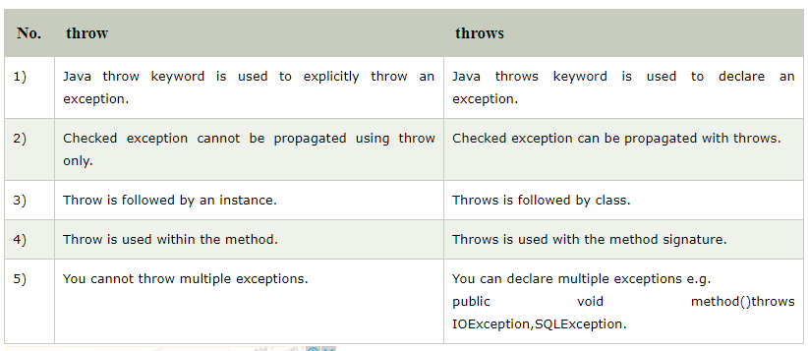

Slide 22
package beginnersbook.com;
import java.io.*;
public class ThrowExample {
void mymethod(int num)throws IOException, ClassNotFoundException { if(num==1)
throw new IOException("Exception Message1");
else throw new ClassNotFoundException("Exception Message2"); } }
class Demo{
public static void main(String args[]) {
Try {
ThrowExample obj=new ThrowExample();
obj.mymethod(1); }
catch(Exception ex) {
System.out.println(ex); } } }
Output:
java.io.IOException: Exception Message1

Slide 23
Exception Handling
Task # 1:
Write a program based on Exception handling and include any three types of built-in exceptions in your program.
Task # 2:
Write a program and create your own exception in it.

